Slide 1

Date: | Human Biology Year 12 ATAR
Do Now Past paper questions on Body fluid and Blood Gas Homeostasis Lesson Agenda 1: Do Now 2: Disruptions to homeostasis (revision) 3: Biotech in treatment of disruptions (revision) 4: Review Worksheet 5: Lesson summary and wind-up Suggested Study Complete review worksheet, then mark and correct using the answer key on Connect Read through today’s notes and textbook section NEXT LESSON Revise for upcoming assessments. *Bring your book, notes, and Dot Point Book. | Learning Aims Review Disruptions to Homeostasis Review Biotech in Disease Treatment
 | Key Vocabulary Homeostasis Stem Cell Disruption Disease

Slide 2

Disruptions to Homeostasis
Review from several different chapters of HP

Slide 3
Disruptions to homeostasis
Can cause serious disease and/or death if untreated
Cells can only function within a narrow range of conditions.
Disruptions focused on in Human Biology
Hormonal disruption
Diabetes Mellitus Types 1 and 2
Thyroid imbalance and disease
Growth hormone imbalance and disease
Behavioural causes of disruption
Lifestyle choices – exercise, food, choices to use drugs, alcohol
Diseases of body systems
Emphysema
High blood pressure
Injury

Slide 4
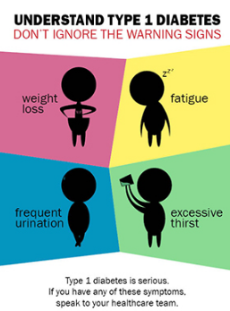
Hormonal Causes of Disruption – Diabetes mellitus
Diabetes Mellitus
Means “sweet urine”
Two types – Type 1 and Type 2
Type 1 Diabetes:
Also called “insulin-dependent” diabetes
Childhood onset
Immune destruction of beta cells in Islets of Langerhans
No insulin produced
Glucose can’t enter cells – body starts to break down protein → ketoacidosis
Symptoms:
Tiredness - cells being unable to access glucose for metabolism
Extreme thirst - glucose in blood raises osmotic pressure – how does this cause thirst?
Frequent urination - increased drinking from thirst
Weight loss – cells cannot access glucose for metabolism
Treatment:
Insulin injections as it is not being made by the pancreas
Careful diet and exercise.

Slide 5
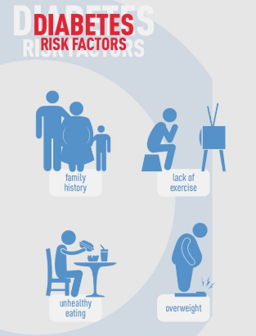
Hormonal Causes of Disruption – Diabetes mellitus
Type 2 Diabetes: a lifestyle disease
Also called “adult-onset diabetes”
Can produce insulin, but cells do not respond by allowing glucose to enter.
Lifestyle factors involved:
Lack of physical activity
Being overweight or obese
High sugar, fat and salt diet, low fibre intake
High blood pressure
High cholesterol
Smoking
Symptoms:
Develops gradually
Extreme thirst – increased blood glucose increases osmotic pressure
Frequent urination – due to increased thirst
Weight loss (not always) – glucose can’t enter cells for metabolism.
Tiredness – glucose can’t enter cells for metabolism
Treatment:
better diet, exercise, lifestyle can reverse or control symptoms
Sometimes medication

Slide 6
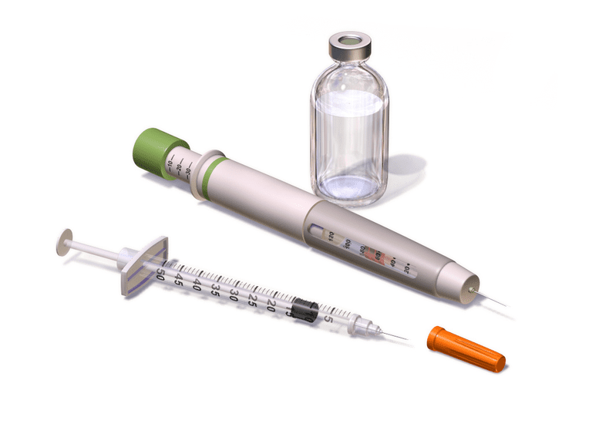
Diabetes mellitus: a disorder of glucose regulation
Common Cause(s) | Symptoms | Diagnosis | Treatment
Type 1 Diabetes: Autoimmune attack of pancreas destroys islet tissue. Little to no insulin produced | Usually childhood onset Extreme thirst Excessive urination Weakness Fatigue Diabetic ketoacidosis – odd smelling breath due to ketones Death if untreated | Blood test to show high blood glucose levels. Presence of glucose in urine. | Daily insulin injections, accompanied by careful diet and exercise regime.
Type 2 Diabetes: Lifestyle cause with some genetic components. Cells become resistant to insulin, so it cannot be absorbed | Adult onset (45+) Few symptoms at first As severity increases: Thirst Excessive urination Weakness Poor wound healing Headaches Dizziness |  | Lifestyle changes Weight loss Regular exercise Low sugar, good quality diet Medication to manage insulin resistance

Slide 7

Hormonal Causes of Disruption: Thyroid hormone imbalance and disease
Problems with Thyroid hormone production affect homeostasis, causing disease.
Hyperthyroidism – Too much Thyroid hormone produced
Hypothyroidism – Too little Thyroid hormone produced
Over or under secretion of thyroid hormone affects metabolism (basal metabolic rate)
Can be due to
Thyroid gland dysfunction
TSH secretion problems from the pituitary
Lack of iodine required to make Thyroxine

Slide 8
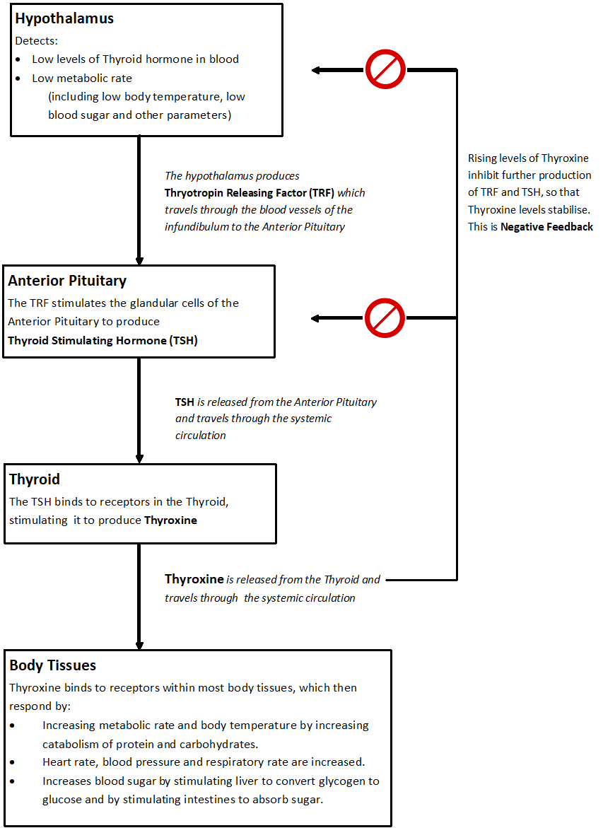
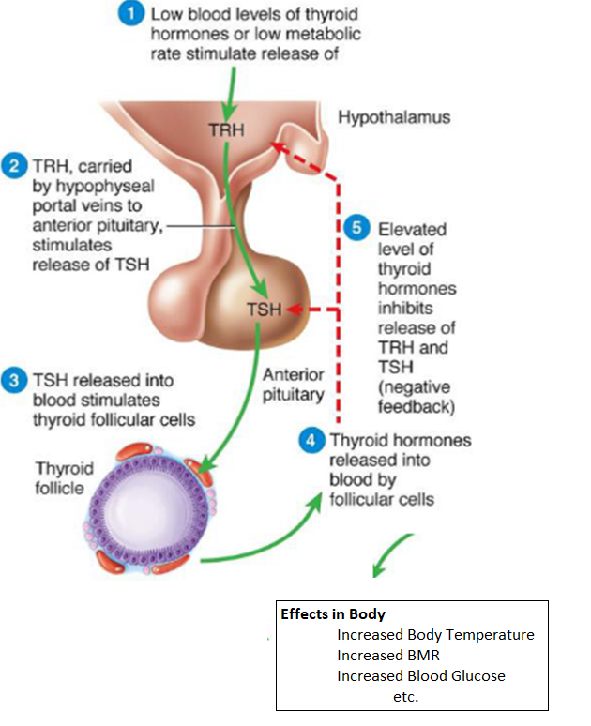
Review: Normal Regulation of Thyroxine production

Slide 9
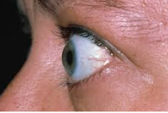
Hyperthyroidism
Enlargement of thyroid and increased production of hormone due to immune system reaction
“Graves’ Disease”
Too much thyroxine produced – metabolism is boosted beyond homeostatic requirements:
Rapid heartbeat (to supply additional O₂ to cells and remove CO₂₎
Weight loss (nutrients eg glucose are being metabolised more quickly)
Increased appetite (to bring in additional glucose for heightened metabolism)
Fatigue (difficulty in supplying cells with glucose etc for heightened metabolic need)
Sweating (increased body heat due to increased metabolism)
Anxiety
Sometimes protruding eyeballs
Treatment:
Drugs that block use of iodine
Surgery to remove part or all of gland
Radioactive iodine therapy

Slide 10
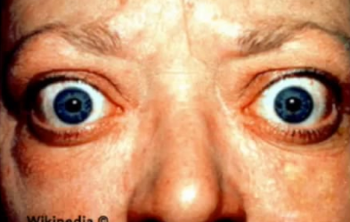
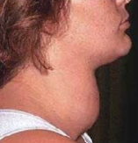
Hyperthyroidism – too much thyroid hormone
Common causes: | Symptoms | Diagnosis | Treatment
Graves’ Disease – immune system produces antibodies which stimulate thyroid to produce hormones | Weight loss - usually (or gain sometimes) Increased appetite Protruding eyeballs Fast heart rate Sleep disturbances Anxiety/nervousness Fatigue Muscle weakness Goitre – from inflammation causing swelling of thyroid | Blood test for TSH – lower than normal as excess thyroid hormone inhibits production of TSH via negative feedback. Testing for antibodies Radioactive iodine uptake by thyroid Ultrasound/CT scan/MRI | Radioactive iodine therapy given as medication taken up by thyroid destroys thyroid cells Less thyroid hormone produced Anti-thyroid medication Prevents thyroid from using iodine to make hormones Surgery Removes part or all of thyroid to lower production of thyroxine.
Thyroid nodules/adenoma – iodine deficiency causes overgrowth of thyroid tissue to try to produce more hormone, which also impacts on TSH production.
Thyroiditis – inflammation of the thyroid causes overproduction of hormone

Slide 11
Hypothyroidism – too little thyroxine
Too little thyroxine produced – so metabolism slowed below homeostatic requirements.
More common than hyperthyroidism.
Can be caused by problems with.
Thyroid gland producing too little TSH
Lack of iodine required to make Thyroxine
Pituitary production of TSH leading to under-stimulation of thyroxine
Hypothalamus producing to little TRF
Symptoms:
Slow heart rate – metabolic rate is slower, not as much need for glucose and O₂ to get into cells.
Unexplained weight gain – cells are not metabolising glucose as fast for ATP, so glucose stored as fat.
Fatigue – slower metabolism means not enough ATP supplying muscles
Intolerance to cold – slower metabolism means less body heat produced.
Goitre – in cases where lack of iodine is the cause, the thyroid overgrows in an attempt to produce thyroxine, but can’t because there isn’t enough iodine to make the thyroxine.

Slide 12
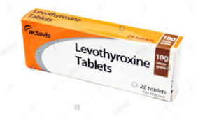
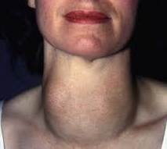
Hypothyroidism – too little thyroid hormone
Common Causes | Symptoms | Diagnosis | Treatment
Hashimoto’s Disease – autoimmune disease attacks thyroid tissue, destroying it so it cannot produce hormone. | Fatigue Weakness Weight gain Depression Cold intolerance Dry, rough skin Brittle dry hair Goitre | Blood test – low levels of T4, high levels of TSH, as low T4 stimulates hypothalamus and pituitary to try to produce more hormone. If it is caused by a pituitary or hypothalamus issue so no TRF ors TSH is produced, the levels will be low, but this is far less common. | Thyroid hormone replacement medication: Levothyroxine Synthetic thyroid hormone tablets Replace missing hormone
Thyroid destroyed by medication or surgery to correct hyperthyroidism
Not enough dietary iodine – mostly a problem in developing nations – body can’t produce hormone without iodine

Slide 13

Hormonal Causes of Disruption: Growth Hormone Imbalance and Disease
Problems with Growth Hormone production affect homeostasis, causing disease.
Growth Hormone Hypersecretion: too much growth hormone.
Growth Hormone Deficiency: not enough growth hormone.

Slide 14
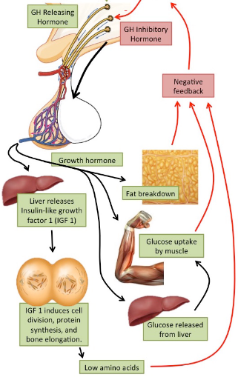
Review: Normal Growth Hormone Regulation
Growth Hormone Releasing Hormone (GHRF) released from Hypothalamus in response to:
Sex hormone interactions, eg during puberty
Action of certain neurotransmitters
Sleep (especially deep sleep)
Nutrition
Exercise
GHRF triggers Growth Hormone release from the anterior pituitary. Growth hormone enters the blood.
Growth hormone has effects on body as discussed.
Negative feedback:
Rising levels of Growth Hormone in blood, rising levels of fatty acids, glucose uptake by muscle, and low amino acid levels trigger release of somatostatin (Growth Hormone Inhibitory Hormone/Factor) from the Hypothalamus, which inhibits further Growth Hormone release by pituitary.

Slide 15
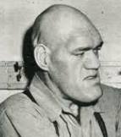

Growth Hormone Hypersecretion
Common Cause(s) | Symptoms | Diagnosis | Treatment
Commonly: Benign tumours on anterior pituitary gland causing oversecretion of Growth Hormone. Occasionally: as a result of inherited diseases or chromosomal abnormalities | Adults: Acromegaly Larger than proportion hands and feet Thick toes and fingers Prominent jaw and forehead Coarse facial features Sweating Headaches Weakness/fatigue Insomnia | Blood test for Insulin-Like Growth Factor Glucose tolerance test MRI to confirm presence of pituitary tumour(s) | Targeted radiation therapy to shrink tumours Microsurgery to remove tumours Somatostatin medication to inhibit GH release
 | Children: Gigantism As above, but greater than normal height also.

Slide 16
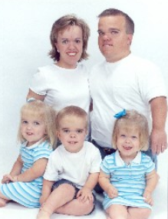
Growth Hormone Deficiency
Common causes | Symptoms | Diagnosis | Treatment
Often no cause can be established in children Can go together with other pituitary diseases Childhood onset may be due to: Heritable gene mutations Congenital disease or malformation Adult onset may be due to pituitary damage from Radiation Surgery Autoimmune attack of pituitary | Childhood onset: Short stature – may be proportional or non-proportional. Slow growth rate. Slower muscle development. Unusual facial features – prominent forehead. Adult onset: Decrease in muscle and bone mass Heart problems Baldness (men) Decreased energy and strength | Blood test to look for abnormally low growth hormone levels. | Treatment with injections of growth hormone. Recombinant gene technology Gene to produce growth hormone spliced into bacteria Genetically engineered growth hormone produced by bacteria

Slide 17
Behavioural Causes of Disruption
Individual behaviours can be unhealthy and therefore disrupt homeostasis.
For example:
Drugs: medicinal drugs assist with maintaining homeostasis, but non-prescription drugs eg. alcohol may disrupt homeostasis, often by interfering with neurotransmitters.
Excessive activity/exercise: exercise is good for you, but excessive exercise can put undue strain on the body eg tendons and joints.
Eating habits: these can contribute to lifestyle diseases, but can also contribute to malnutrition if intake is inadequate.

Slide 18
Disease Disrupts Homeostasis
Diseases disrupt homeostasis by interfering with functioning of the body. Some examples include:
Emphysema – break down of alveoli – impacts on ability to maintain homeostatic levels of O₂ and CO₂.
Very High Fever – elevation in body temperature can impact ability to maintain chemical reactions required for life.
High blood pressure – inability to bring blood pressure into homeostatic range can interfere with kidney function and also increases risk of heart attack and stroke.
Injury – may cause blood loss, or allow infection entry, interfering with homeostasis.

Slide 19

Hormones and Recombinant DNA Technology - Review
Ch 2 HP, Ch 8 HP

Slide 20
Recombinant DNA Technology
Process of splicing DNA from one organism into another organism
Variety of uses.
Endocrine System uses of recombinant DNA Technology:
Synthetic Insulin
Synthetic Growth Hormone

Slide 21
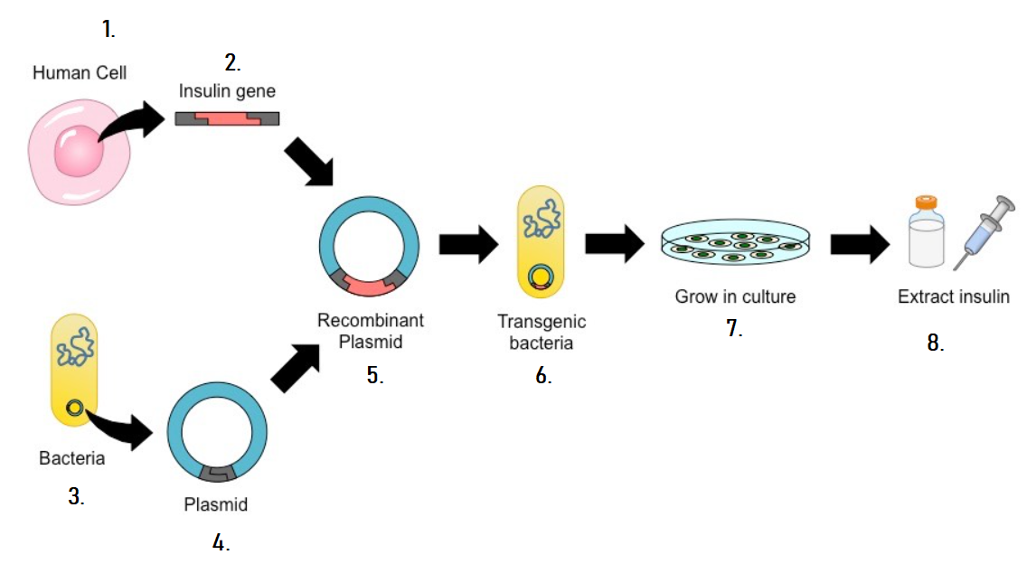
Putting a gene from one organism into another organism
Technology is available to put a gene from one organism into a totally different organism!
For example, scientists can put the insulin gene from a human cell into a bacterium, so that the bacterium produces the hormone insulin, which can then be extracted, refined and used to treat diabetes mellitus.
This involves:
Isolating (cutting out) the insulin gene from a healthy human cell, using a restriction enzyme.
Treating a piece of bacterial DNA with the same restriction enzyme.
Splicing the human insulin gene into the bacterial DNA.
Sticking the spliced pieces together with the enzyme DNA Ligase.
Putting the bacterial DNA back into the bacterium.

Slide 22
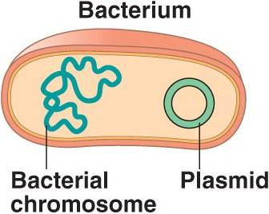
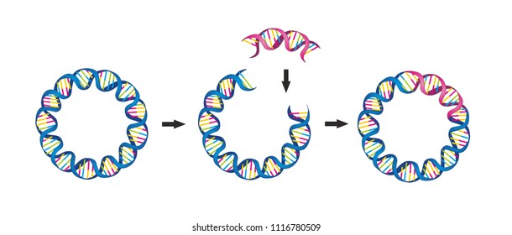
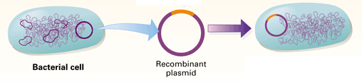
Splicing human genes into bacteria
Bacteria have long strands of DNA, but also have smaller, circular strands of DNA in their cytoplasm.
These small, circular strands of DNA are called plasmids.
Plasmids are removed from bacteria and treated with the same restriction enzymes used to isolate human genes, so the human gene can be spliced into the plasmid.
The plasmid (now containing a human gene, eg for insulin)
is a vector (carrier) that transports the human gene.
The plasmid is placed into a new bacterium, so that bacterium will carry the human gene. If it is carrying the human insulin gene, it will produce the hormone insulin!

Slide 23
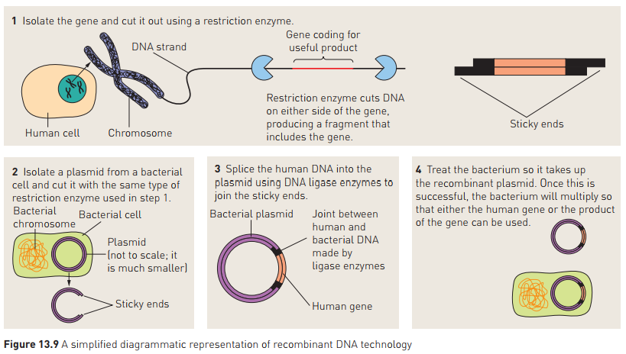

Slide 24
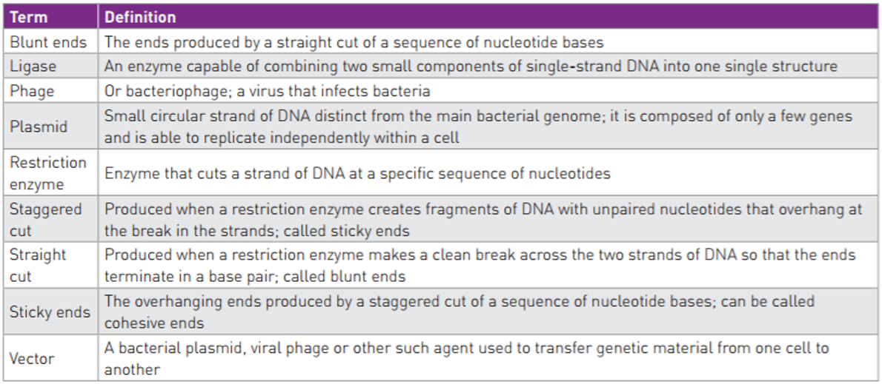
1: The base sequence coding for insulin production (the insulin
gene) is isolated from a healthy human cell.
2: The base sequence on either side of the gene is treated with a
restriction enzyme that cuts the base sequence, leaving a
staggered cut with sticky ends.
3: A plasmid is isolated from a bacterial cell.
4: The plasmid is treated with the same restriction enzyme that
was used on the insulin gene so that it has the same staggered
cut and the same sticky ends.
5: The human insulin gene is then inserted into the bacterial
plasmid, which fits because the plasmid and the gene have the
same staggered cut and sticky ends. The plasmid and insulin
gene are stuck together using the enzyme DNA Ligase.
6: The recombinant plasmid acts as a vector (carrier) of the human
insulin gene. It is inserted into a new bacterium, creating a
transgenic bacterium that contains the gene for human insulin.
Because it contains the gene for human insulin, the bacterium
can now produce human insulin hormone.
7: The transgenic bacterium is grown in culture, where it
reproduces until there is a large number of bacteria, all
producing the human insulin hormone.
8: The bacterial culture is processed to extract the hormone insulin
that the bacteria have produced and it is refined for human use,
to treat Type I diabetes.

Slide 25
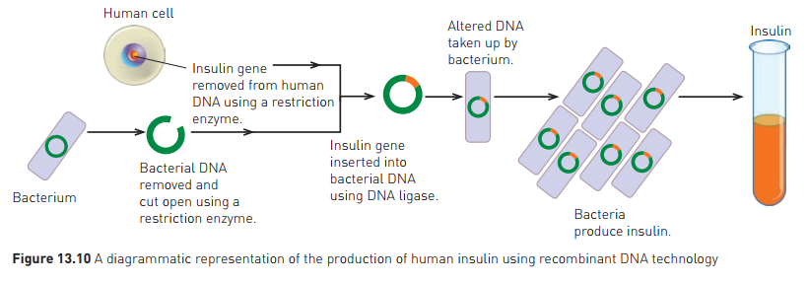
Examples of use
Insulin
Pre-1982, diabetics treated with insulin from pig/cattle pancreas
1982: insulin produced from genetically engineered bacteria approved – “Humulin”
Human gene spliced into bacterial cells, so bacteria would then produce insulin
Insulin now produced in huge vats of bacteria.

Slide 26
Examples of use continued
Human Growth Hormone
Now produced by genetically engineered E. coli bacteria
Used to treat lack of growth hormone in pituitary disorders
Also used in dairy cattle to increase milk production
Note: the process for making synthetic Human Growth Hormone using Recombinant DNA technology is exactly the same as for making synthetic insulin, except the gene for Growth Hormone is isolated and worked with, not the gene for insulin.

Slide 27
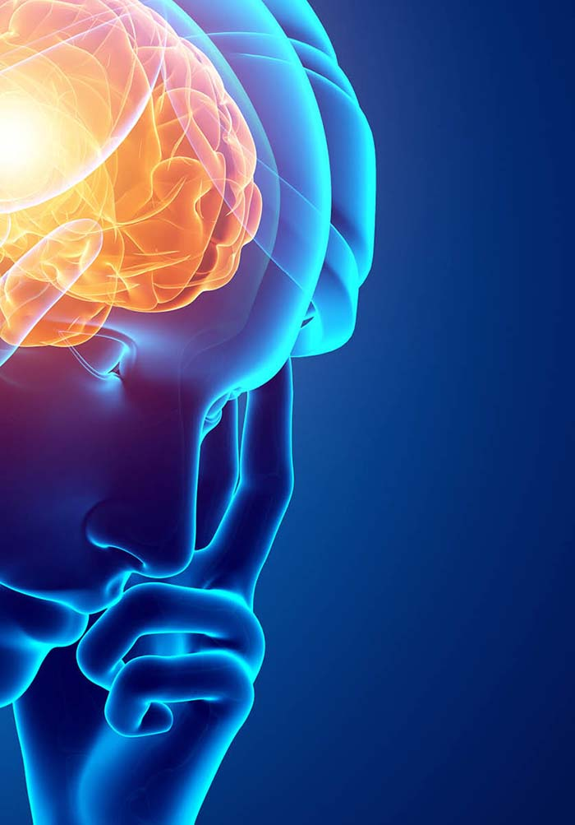
Review: Diseases of the Nervous System and Biotechnology
Ch 4 Human Perspectives –The Nervous System is highly organised
Ch8 Human Perspectives – Technology is used to treat diseases

Slide 28
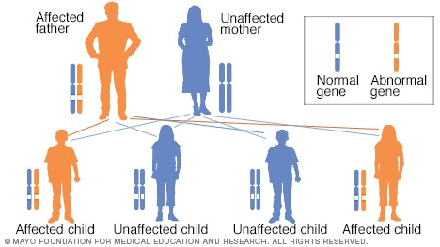
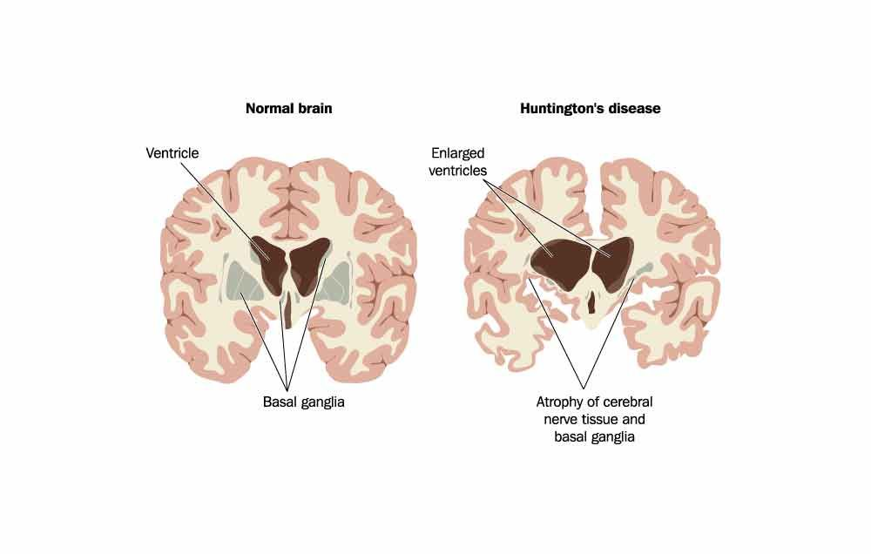
Huntington’s Disease
A single gene disorder – dominant inheritance.
Abnormal gene:
Codes for a mutated protein (huntingtin)
Protein damages nerve cells in the brain
Large
Symptoms start after age 40 and are progressive:
Physical, mental and emotional changes
Progressive dementia, limb flailing.
Currently incurable, fatal.
Possible future treatment: Gene therapy

Slide 29
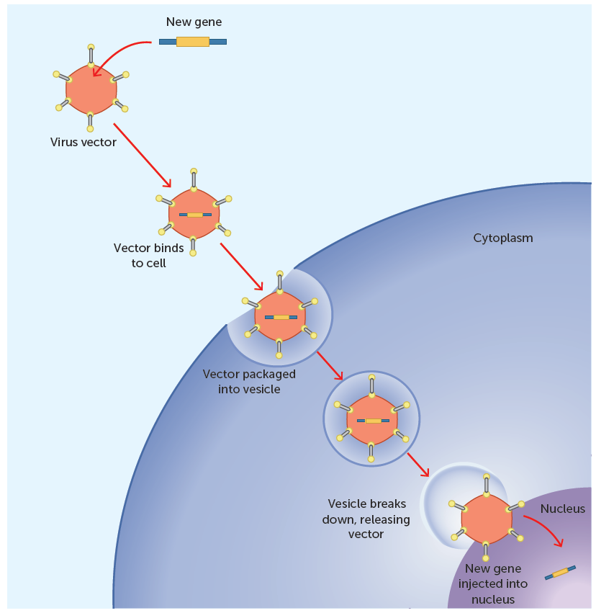
Gene Therapy
Aims to treat or cure disease by identifying faulty genes and inserting healthy ones.
Still in research phase.
Concept is that a vector (eg a virus)can be used to deliver the desired DNA into the cell, to be incorporated by the nucleus and produce desired protein.
Areas of possibility:
Replacing mutated gene with healthy copy*
Eg Huntington’s disease, Cystic Fibrosis, Type I Diabetes
Fixing or inactivating mutant genes*
Eg Huntington’s disease
Inserting a new gene that will fight the disease
Making the immune system recognise diseased cells.
Eg therapy for some cancers
*These ones could be used for Huntington’s Disease

Slide 30
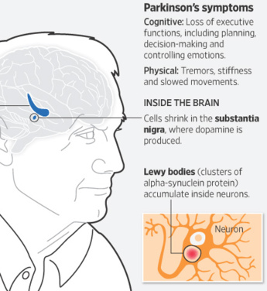
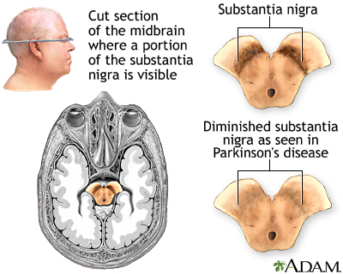
Parkinson’s Disease
Degenerative (progressive) neurological disease
Central NS tissues affected
Cell death in substantia nigra (in basal ganglia) decreases dopamine production causing symptoms
No identified cause of the cell death
Lewy bodies (protein) accumulates inside neurons
Symptoms: Impaired motor skills and speech
Usually diagnosed later in life (between 60 and 70 years old)
No cure, but can be managed.
Future cure may be cell replacement therapy

Slide 31
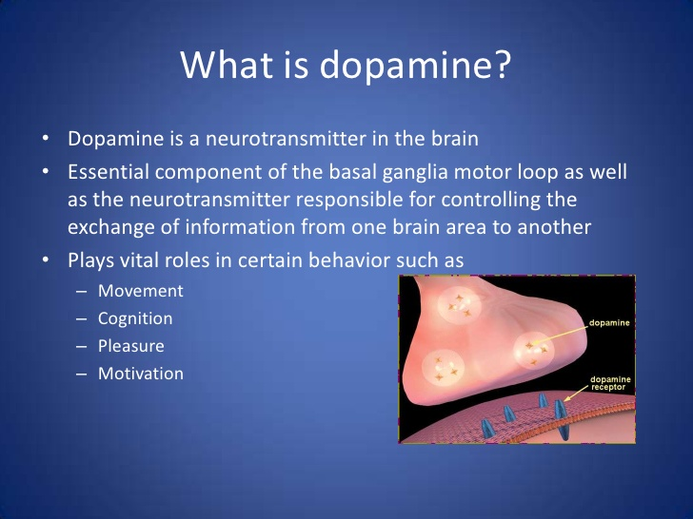
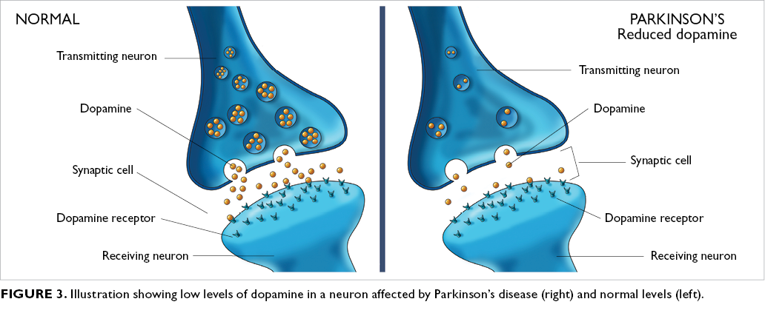

Slide 32
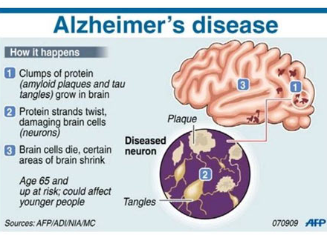
Alzheimer’s Disease
Progressive Degenerative disease of the brain
Usually diagnosed after the age of 65
No clear cause has been established
Disease progression:

Slide 33
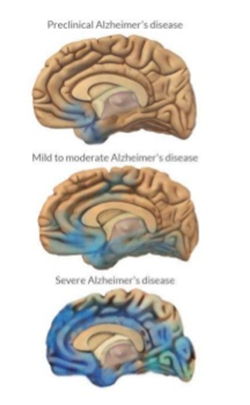
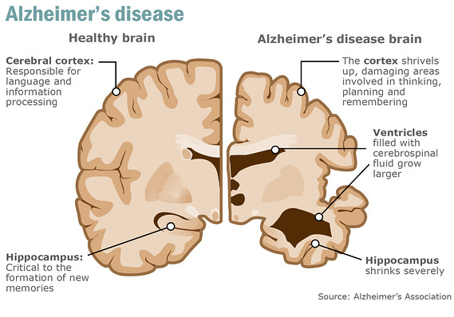
As the disease progresses…
Neurons lose their ability to function and communicate with each other, and eventually die.
As it progresses, neurofibrillary tangles spread throughout the brain (shown in blue). Plaques also spread throughout the brain.
By the final stage, damage is widespread and brain tissue has shrunk significantly.
Currently no cure – future cure could be cell replacement therapy

Slide 34
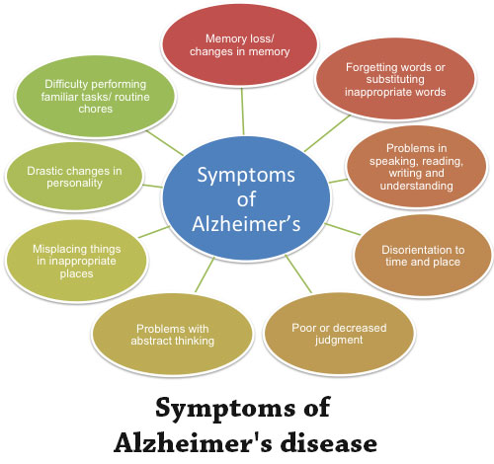

Slide 35
Cell Replacement Therapy
Could be used in future for neurodegenerative disorders such as Alzheimer’s and Parkinson’s.
Replacement of dying neurons with healthy ones derived from stem cells
Can grow and differentiate to replace damaged tissue
Controversy surrounding use of human embryonic stem cells
Other sources of stem cells are being researched
Technique not yet refined – is a potential future treatment.
Adult stem cells are isolated from the patient.
These are treated so that they differentiate into the required tissue, and cultured in the laboratory.
The newly differentiated cells are inserted into the damaged areas to regrow healthy tissue.

Slide 36
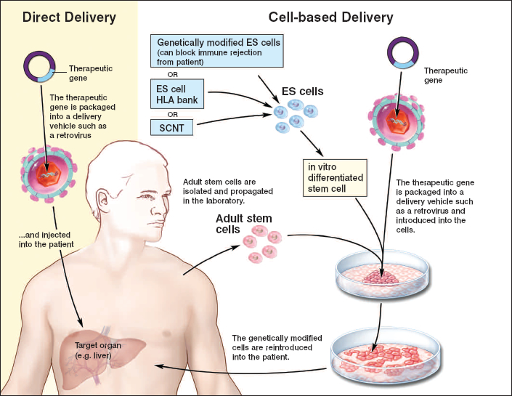
How Cell Replacement therapy might work once it is through the experimental stage:
This example shows the liver as the target organ, but the idea is the same for diseases such as Alzheimer’s and Parkinson’s where a part of the brain is the target.

